Slide 1


Notes:
Team intro: names
Our theme: post-secondary CS education

Slide 2
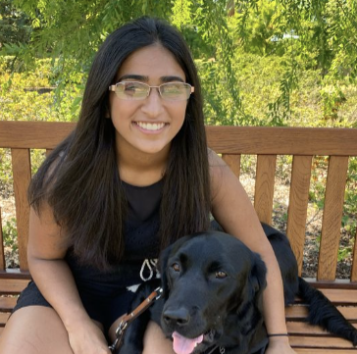



The CoCode Team
Trisha K.
Daniel R.
Juliette W.
Angela C.

Slide 3
Mission Statement: Cocode exists to provide a welcoming and collaborative space that empowers students in postsecondary CS classes to learn and share their knowledge with their peers.

Slide 4
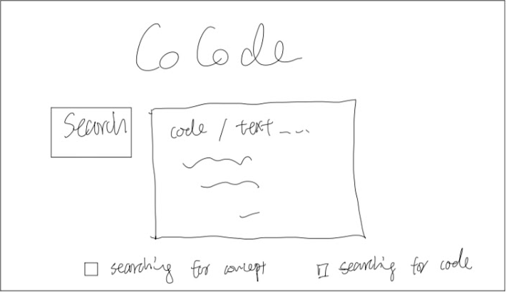
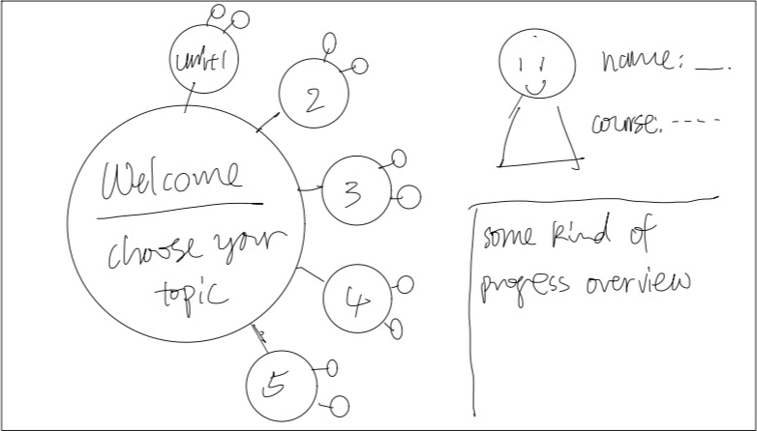
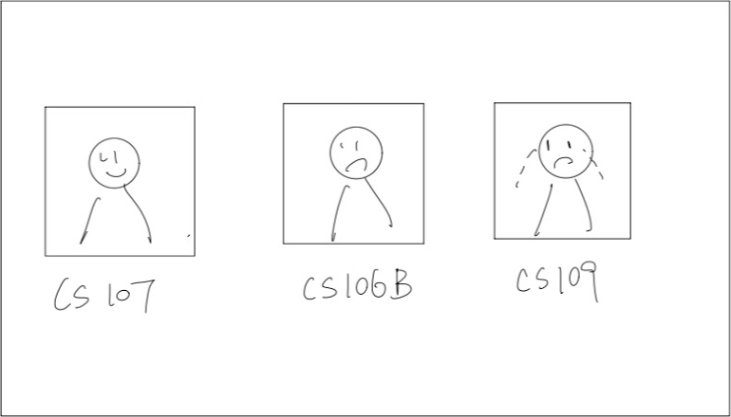
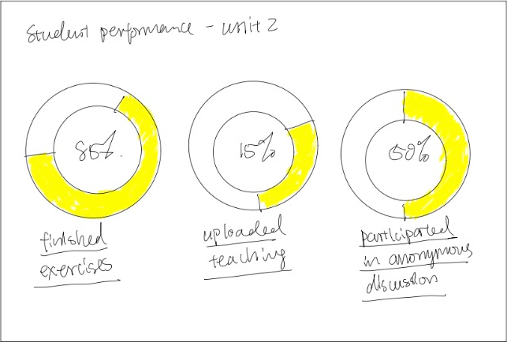
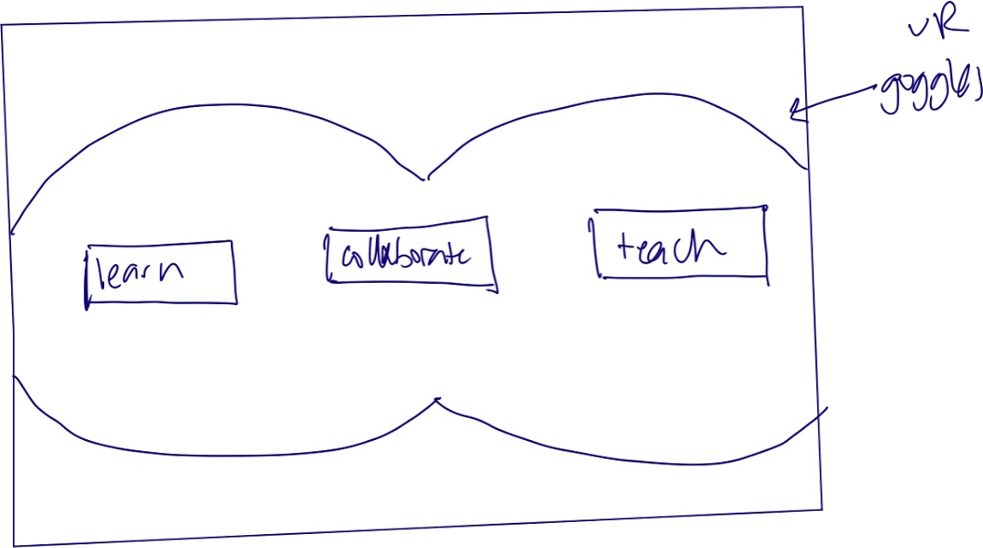
Concepts
Search Based
Educators’ Tablet App
Prezi Study Space
VR Design
Netflix Design

Slide 5
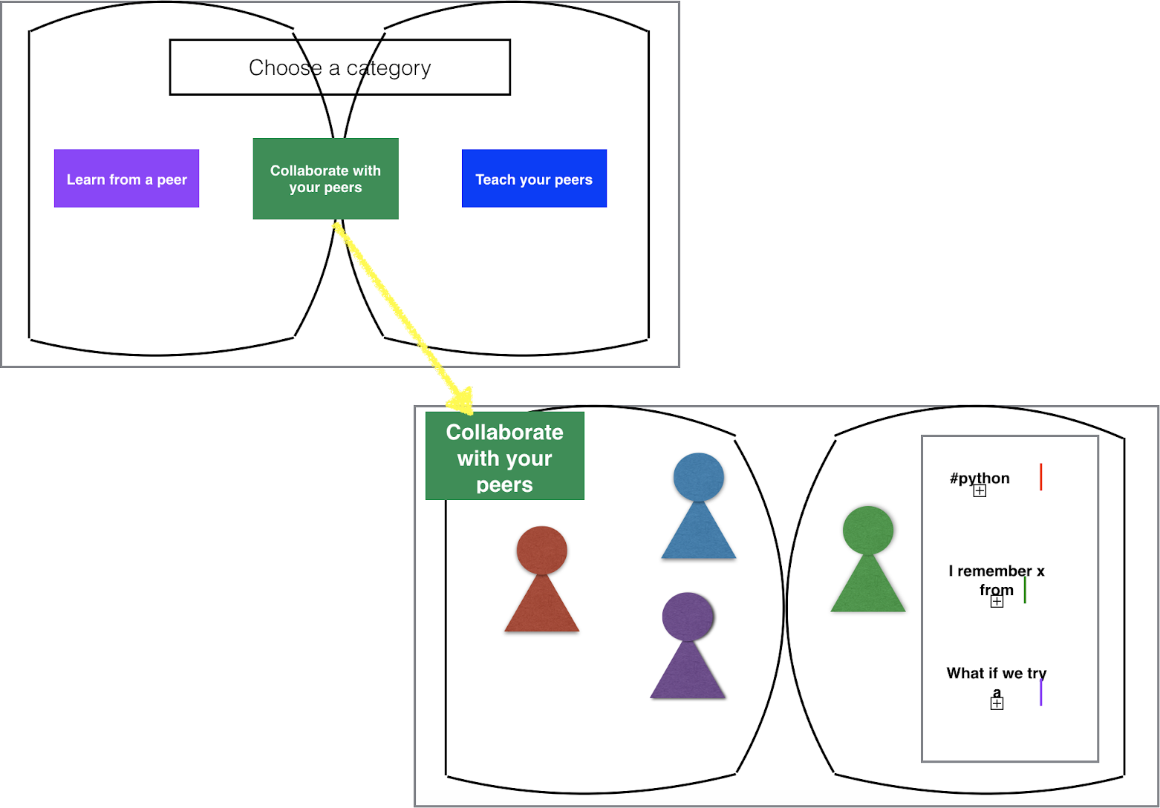
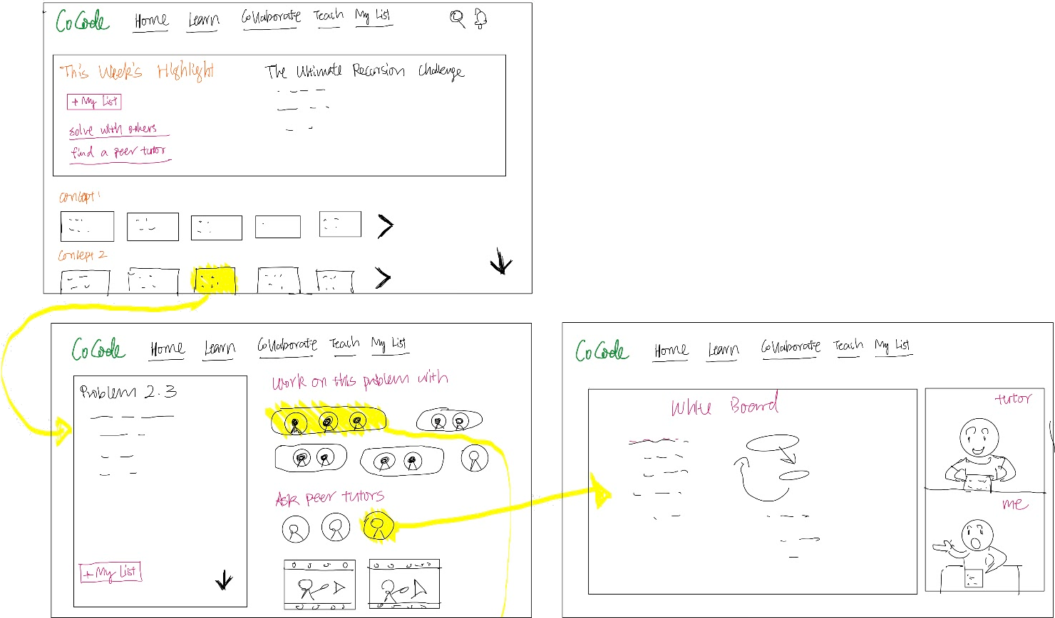
Concepts Selected for UI Sketches
VR Design
Netflix Design

Slide 6
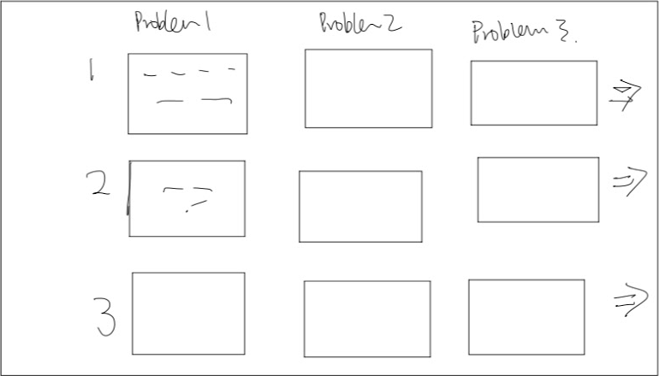
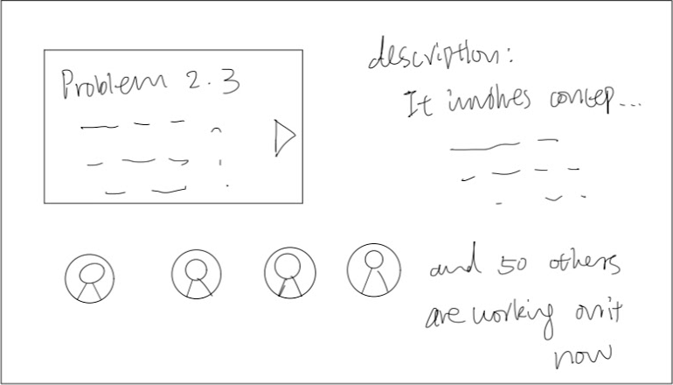
Selected Interface

Slide 7
Selected Interface Rationale
Computer for ease of use (e.g., typing, share screen, etc)
Problem focused navigation-organized and logical
Make exploring CS problems fun (like Netflix)
Tap into familiarity to lower tool-uptake time

Slide 8
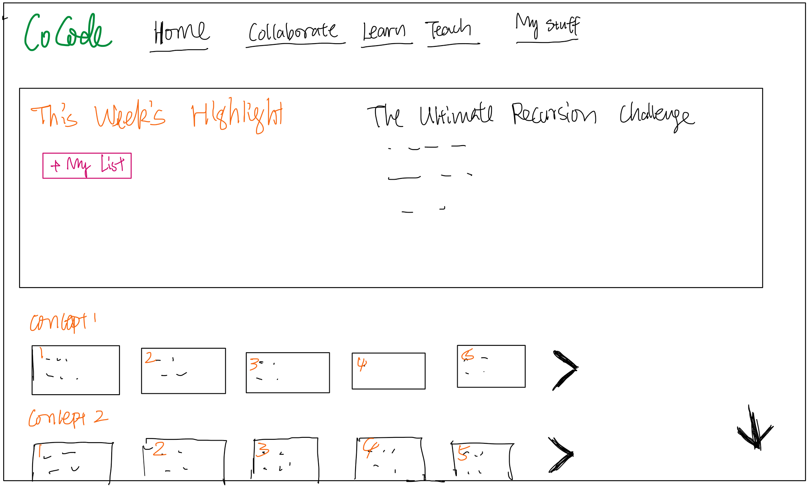
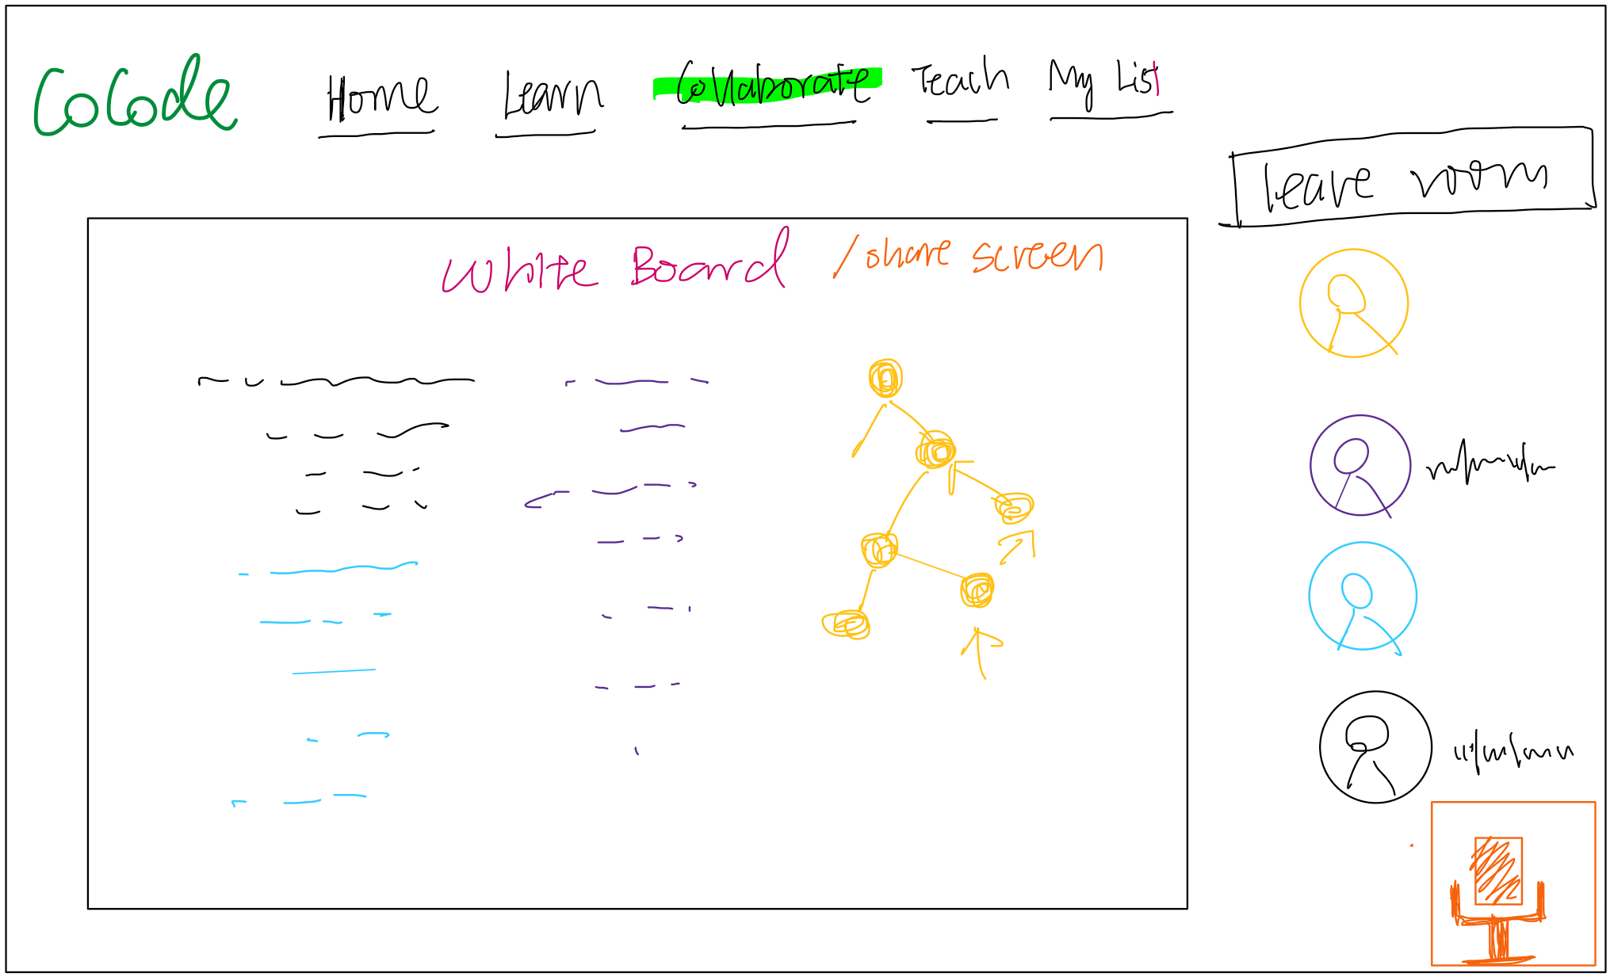
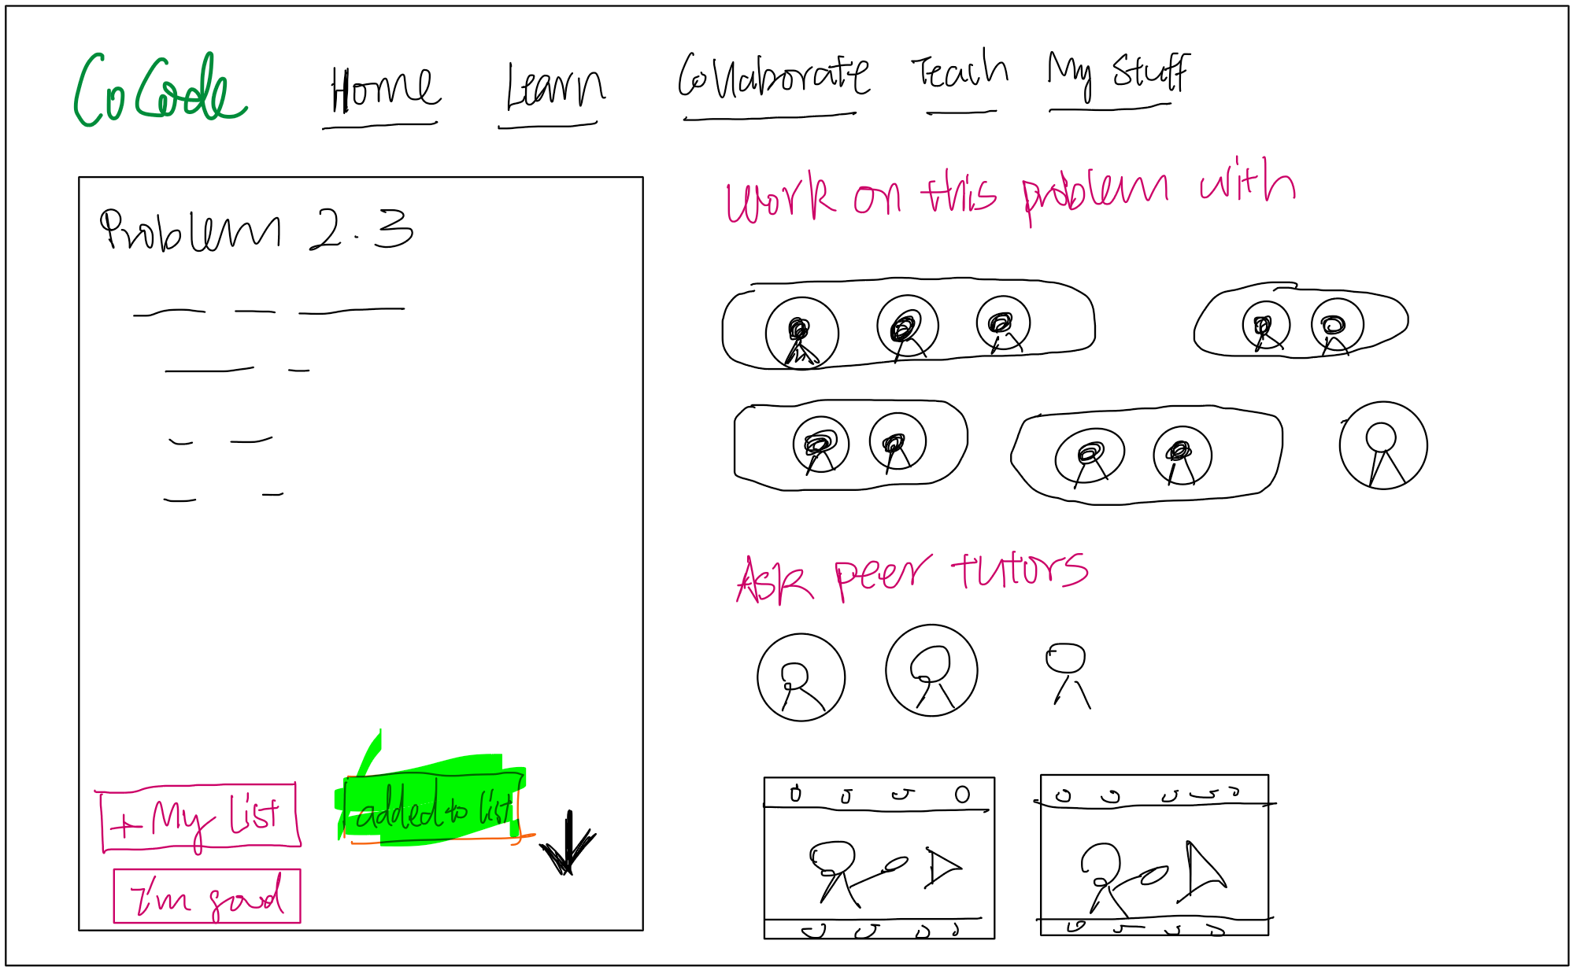
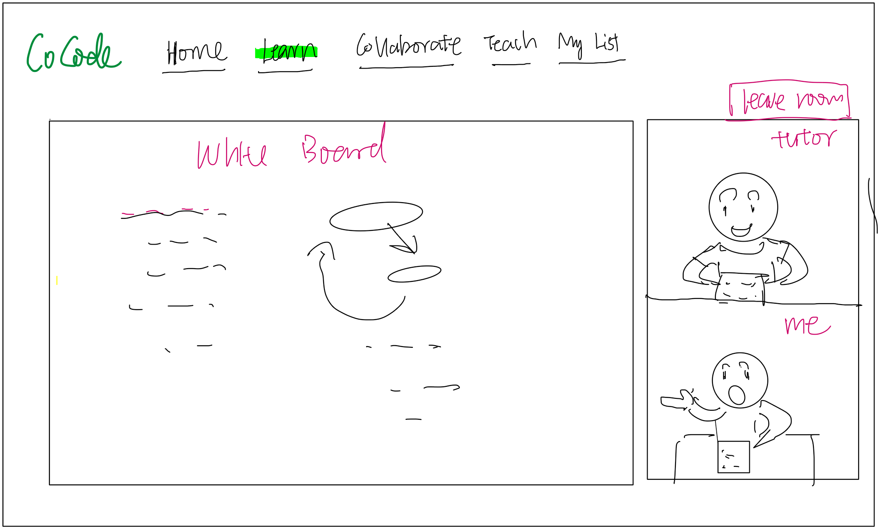
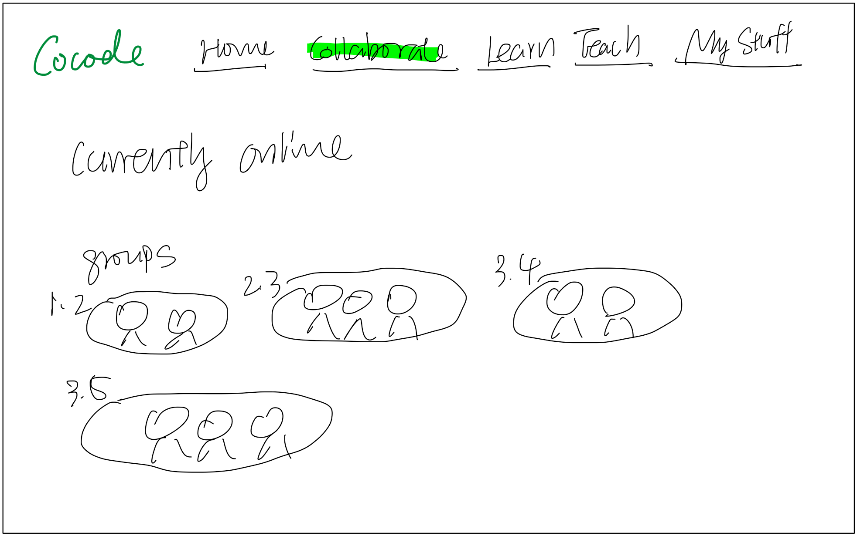
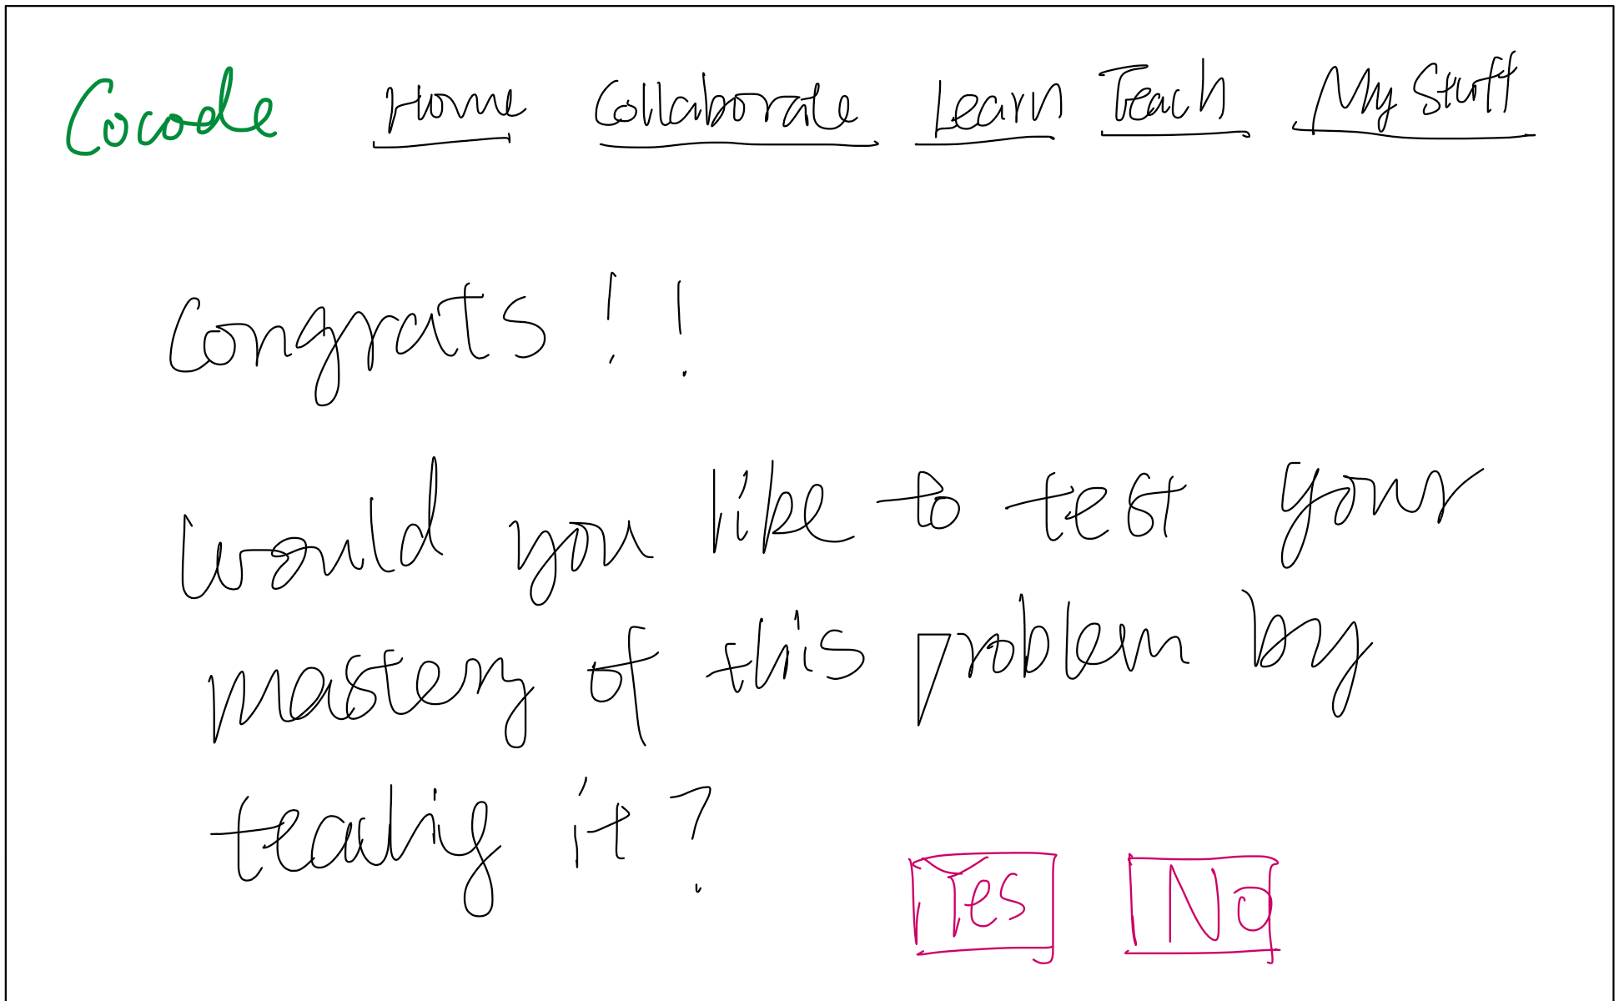
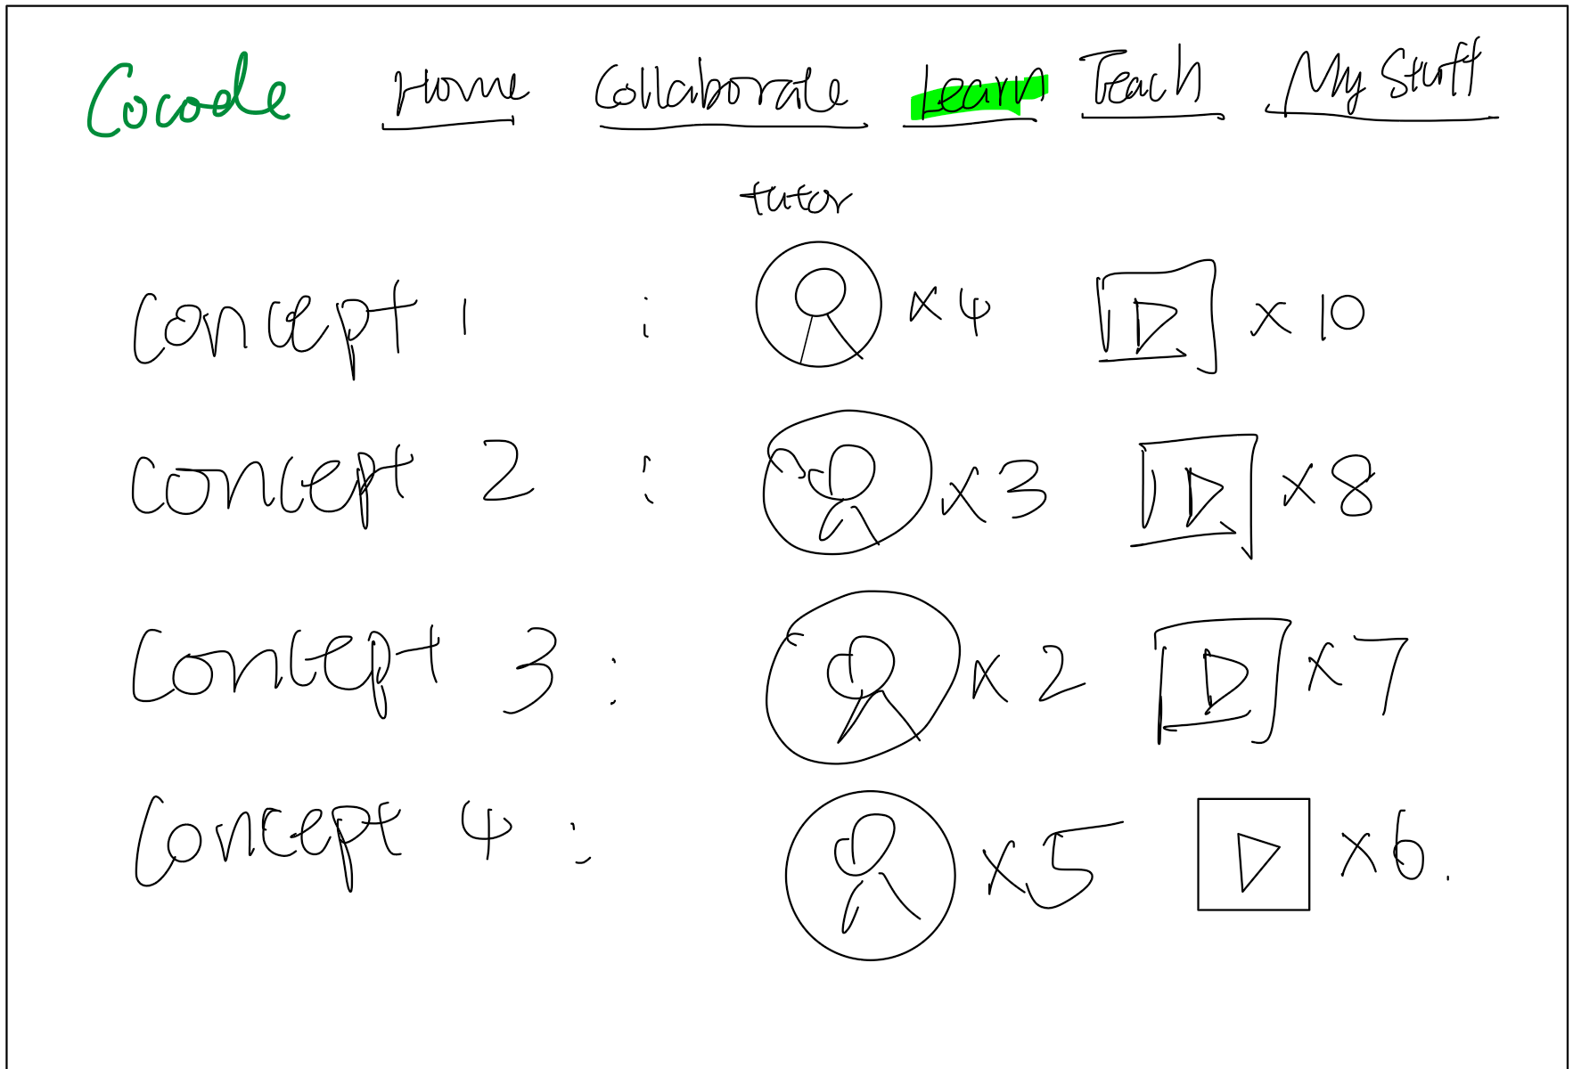
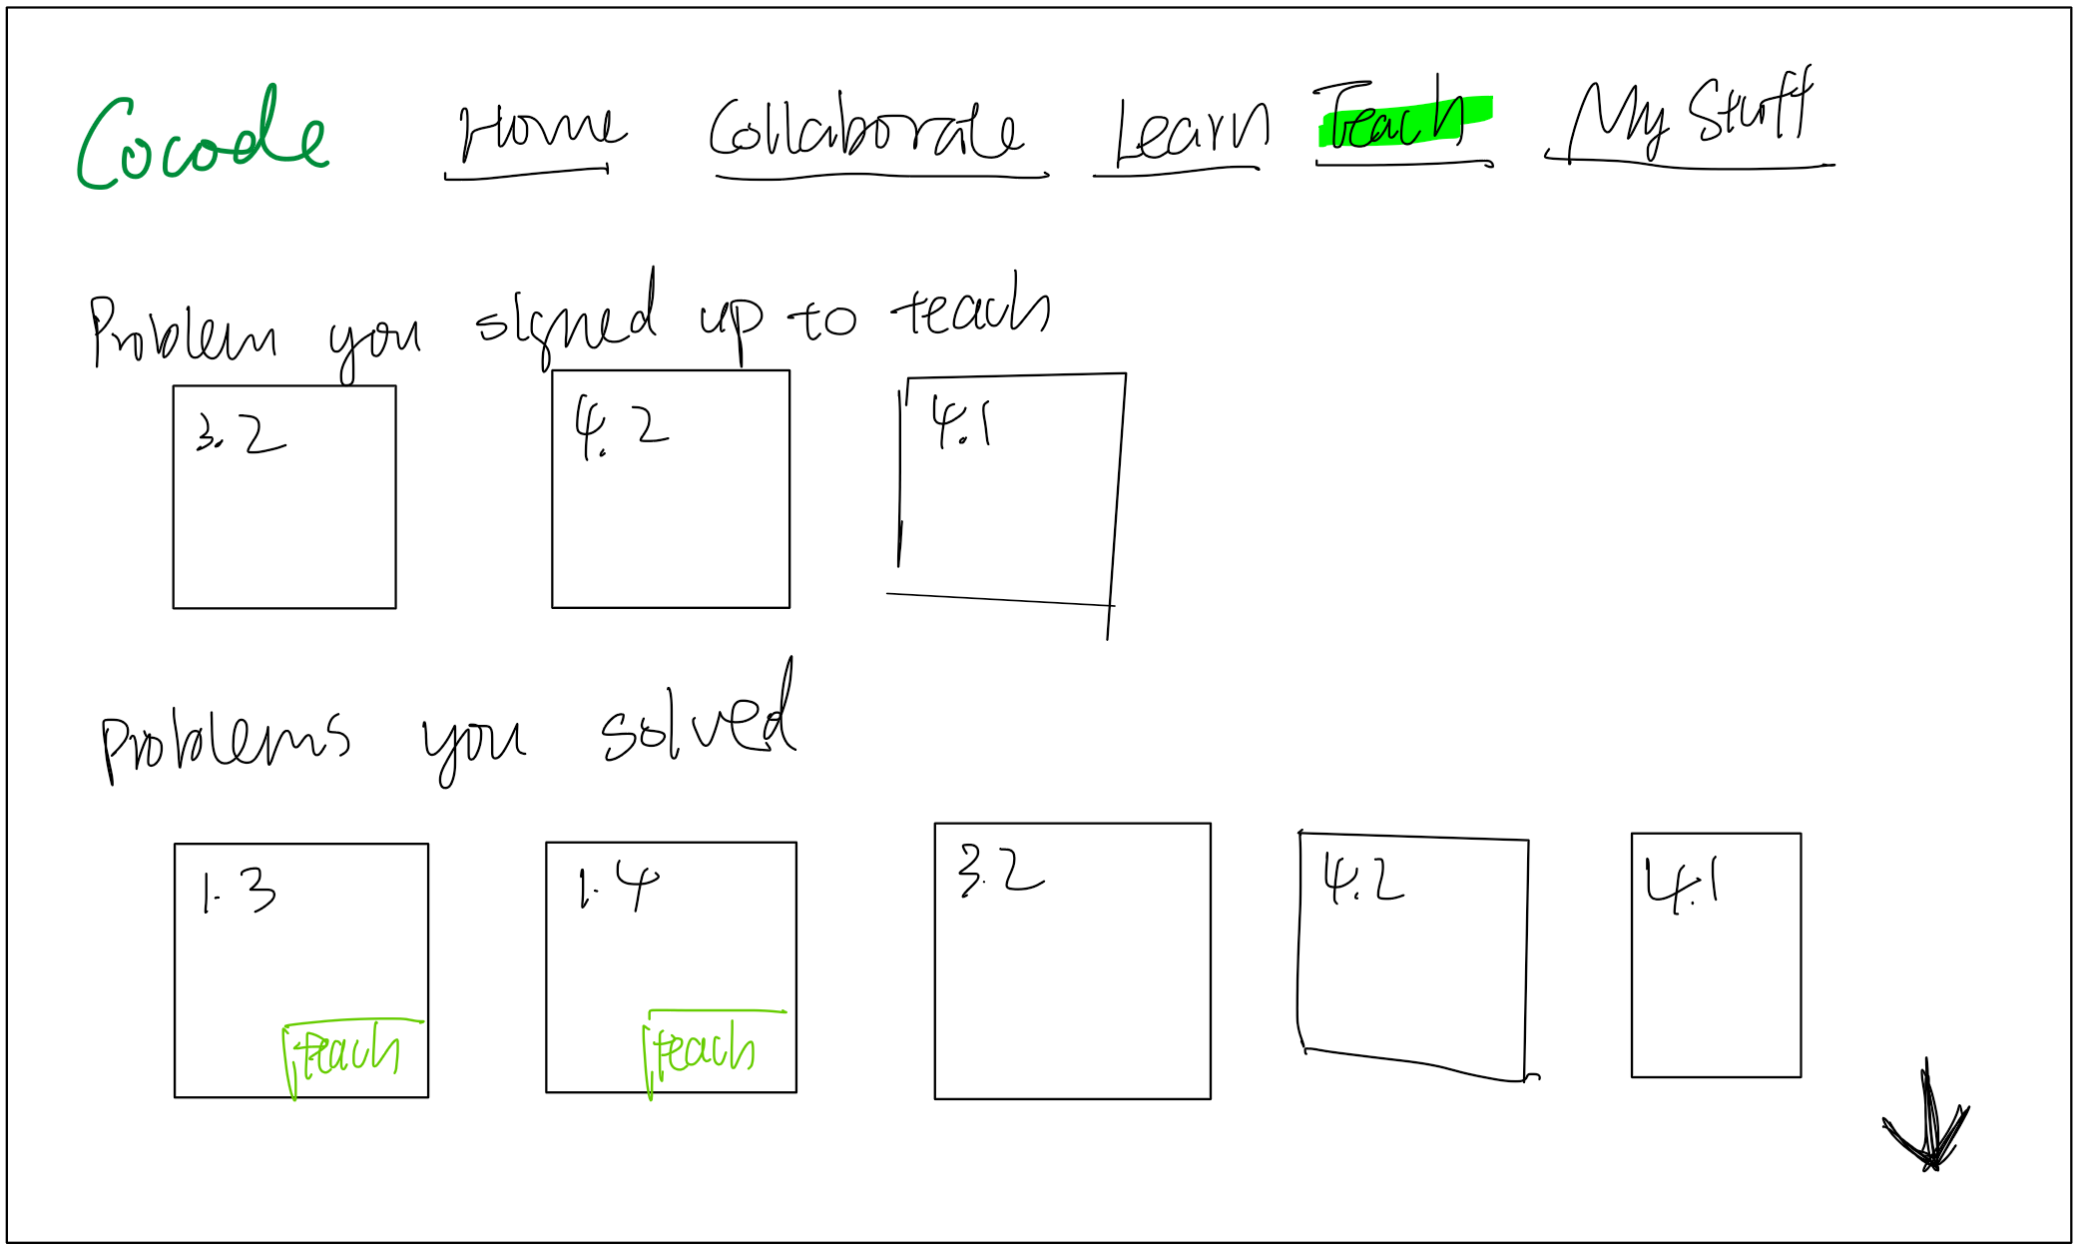
Prototype Structure
Home
Collaborate on a problem
Problem
Learn/teach a problem
Collaborate tab
Prompt to teach
Learn tab
Teach tab

Slide 9

Task 1
Learn from a Peer
“You are taking an introductory computer science class on data structures. It is later in the evening, and you weren’t able to make it to lecture or office hours earlier in the day, which has resulted in you being very stuck getting started on problem four.You go onto this platform seeking a conceptual explanation on breath for search algorithms. Where do you go?”

Slide 10
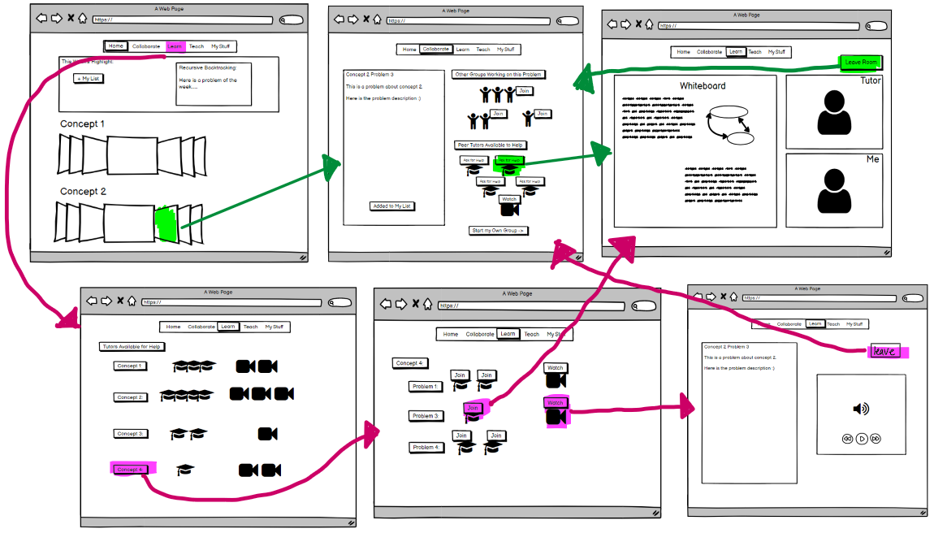

Slide 11

Task 2
Collaborate with Others
“You are preparing for a final exam worth a big portion of your grade, and you go onto our platform seeking discussion and practice with concepts. There are a few clarifications you want to receive about a data structure used in problem four, but you also feel like you have some understanding to share. Where do you go?”

Slide 12
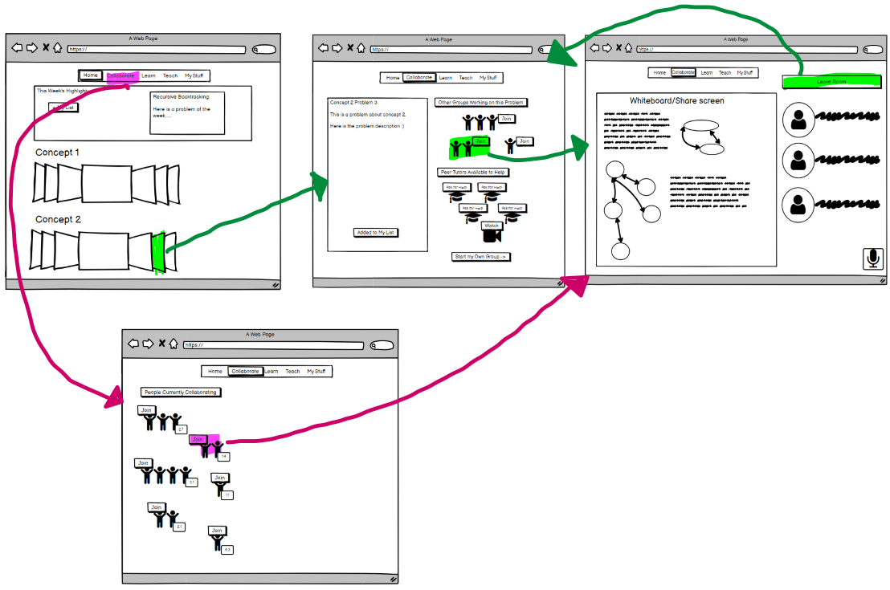

Slide 13

Task 3
Teach a Problem
“After studying for your exam for many hours and succeeding in practicing problem 4 on our platform, you feel much stronger about your understanding of a tough concept. You decide you want to test your mastery and share how you came to think about the problem with others. What do you do?”

Slide 14
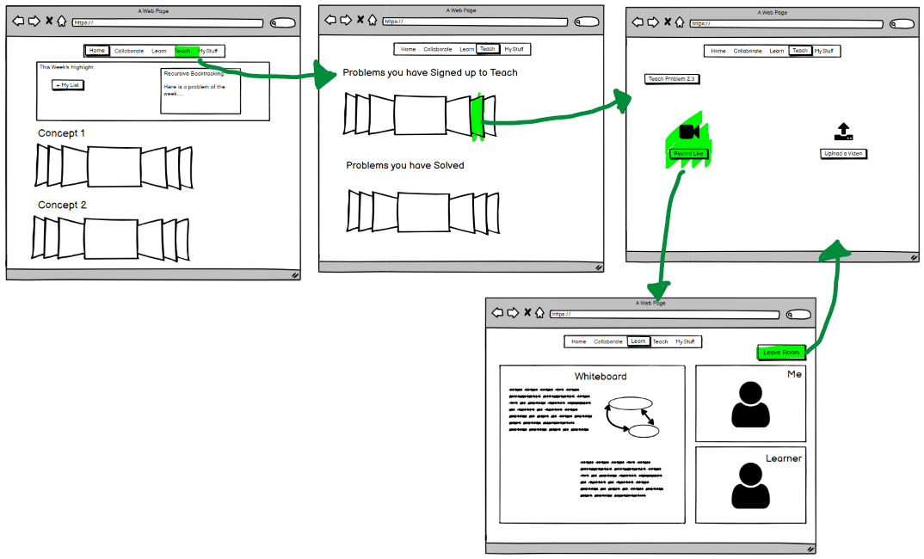

Slide 15



Experimental Method
Participants:
R
V
Z
College junior humanities major at a Midwestern SLAC
Recent college graduate and works as a software engineer.
1st year MS student in EALC at Stanford
Taking CS106A this quarter

Slide 16
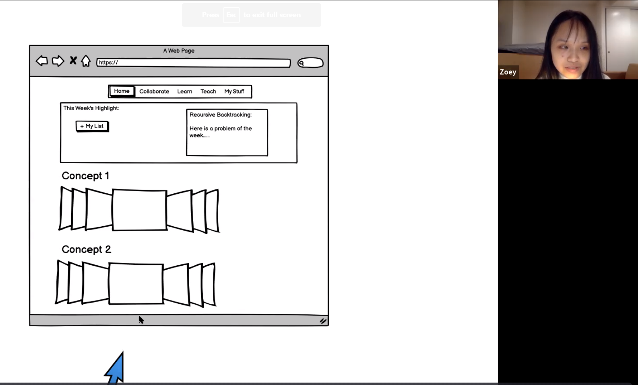
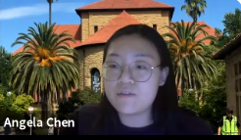




Experimental Method
Participants:
Roles:
Rob
Vineet
Zoey
Trisha
Angela
Daniel
Juliette
Notes:
<div>Icons made by <a href="https://www.freepik.com" title="Freepik">Freepik</a> from <a href="https://www.flaticon.com/" title="Flaticon">www.flaticon.com</a></div>

Slide 17
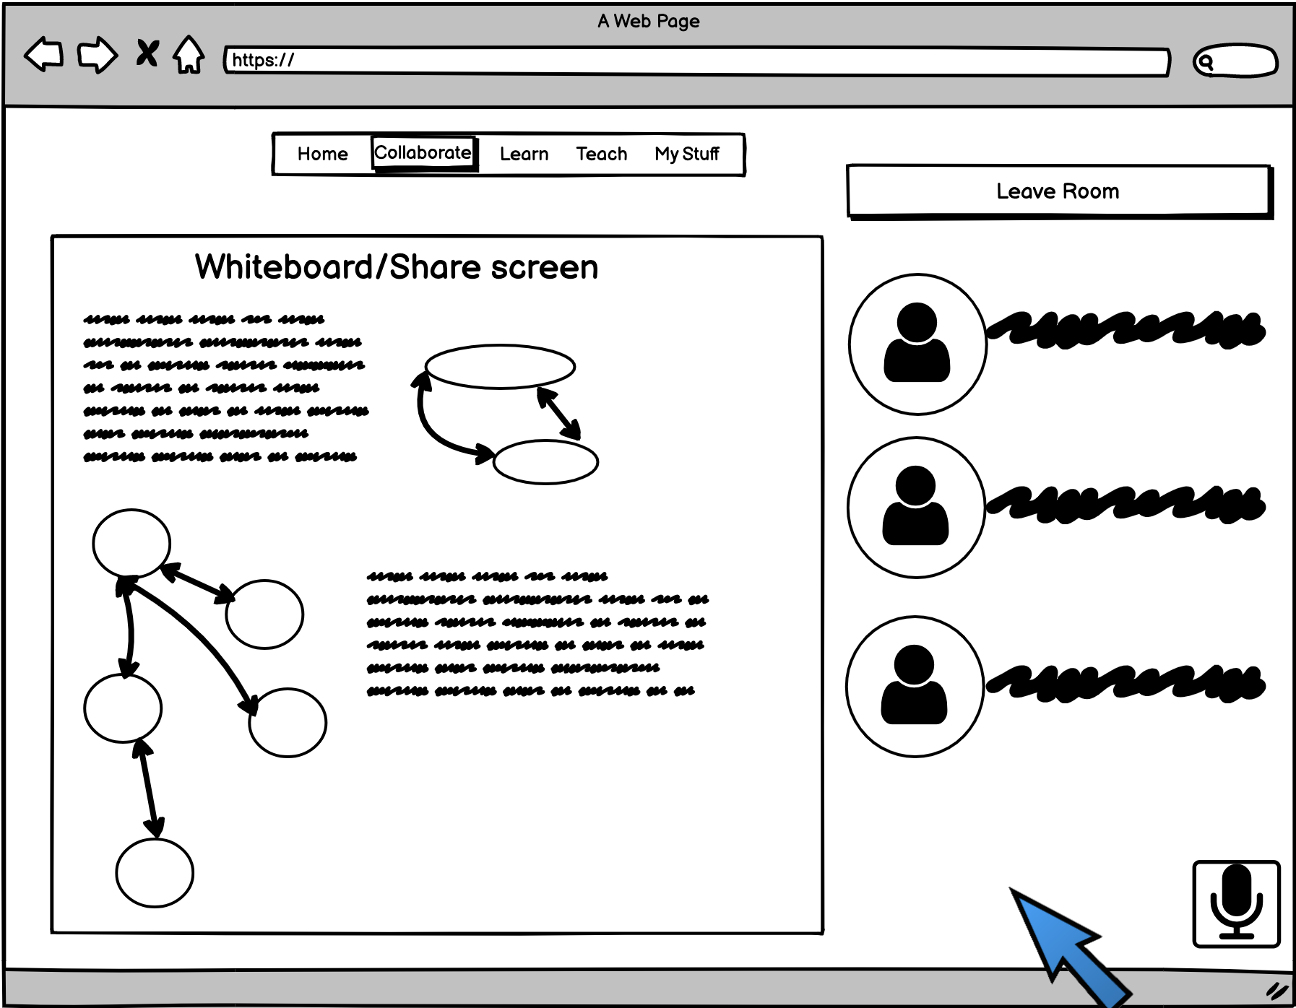
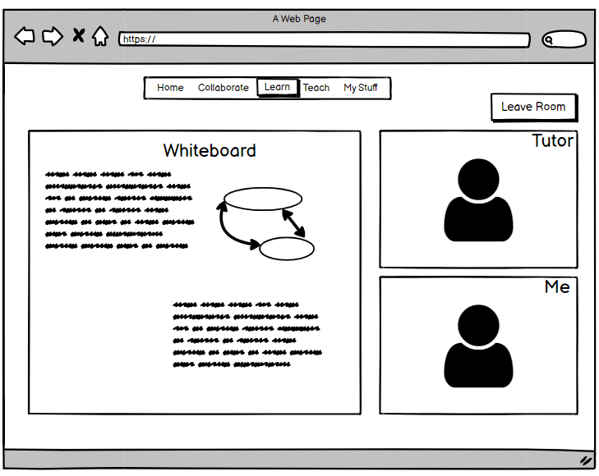
Experimental Results
Finding: The difference between collaborating and learning from a peer tutor was confusing.
We Learned: There needs to be clear tasks that are different for collaborating and learning from a peer

Slide 18
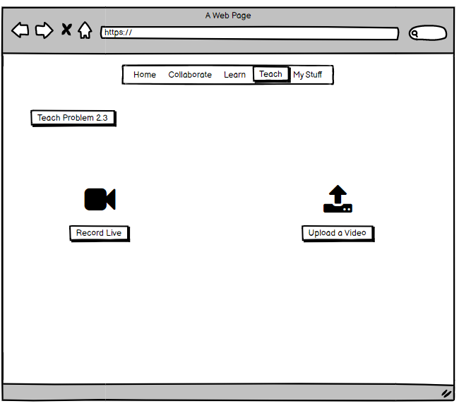
Experimental Results
Finding: All interviewees said they would rather teach another student face to face than record a video for them to watch
We Learned: Students may be more comfortable teaching in real time than recording a head of time

Slide 19
Experimental Results
Finding: All interviewees were confused about what would be on the screen-share when collaborating
We Learned: A collaborative document that they can contribute to might be more helpful/collaborative than one student sharing their screen.

Slide 20

Suggested UI Changes
Specify and add features to whiteboard space: chat, coding environment, personal work space, etc.
Provide resources from lectures or textbooks for students to browse before they seek help
Make signing up to teach a problem more intuitive
Collaboration vs. teaching functions: how do they overlap and differentiated
Reorder the tabs on the top of each page
save/upload the progress on the whiteboard
Show the progress of each discussion room

Slide 21



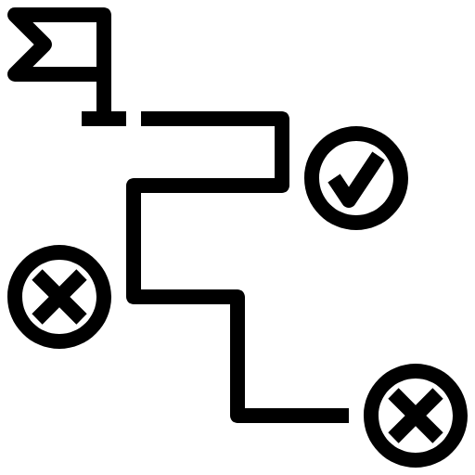
Summary
We chose the concept/problem-specific layout
Task flows and UI are in general intuitive
Improve the detailed functionalities and flows between tasks
Further consideration: logistics - how to make real-time/asynchronous activities feasible

Slide 22
What questions do you have?

Slide 23
Appendix

Slide 24
Experimental Results
Our Findings:
  -most interviewees wanted to review course material before jumping in to a problem and assumed it would be possible from our side but there wasn’t really a way to do that.
  -⅔ interviewees wanted options for anonymous and non-anonymous
  -confused at how the screen-sharing would work
  -preferred video or had no preference (other people have other preferences)
  -interviewees would watch pre-recorded videos first when they are learning but when they are teaching, would prefer to teach live
  -found it showing the most recent course material. Didn’t intuitively know this would be mostly for review of earlier topics rather than practicing the new ones
  -one interviewee wanted to see people’s names to decide which groups to join
  -confused about how to sign up to teach a problem
  -distinction between collaboration and learning is group vs. one-on-one
  -would like the option to continue working on problems with this group
  -all want a chat feature like on Zoom

Slide 25
Experimental Results
What We Learned?
  -if they are going to peer teach, they want to teach other students in real time
  -students want a way to review course material directly from the site
  -students will benefit from a collaborative document rather than one person screen sharing

Slide 26
Experimental Results
What are we going to change?
  -some sort of collaborative writing that isn’t sharing screen
  -whiteboard that has syntax highlighting / latex if relevant
  -change the order of collaborate, learn, and teach to be learn, collaborate, teach
  -provide different options for video on/off and names/anonymous
  -some way to continue working on problems with the same group if you mesh well
  -have links to course contest (lecture recordings, slides, homework, section problems etc) easily accessible for a given concept/problem
  -some sort of chat feature that is less of a commitment than video chat ?

Slide 27
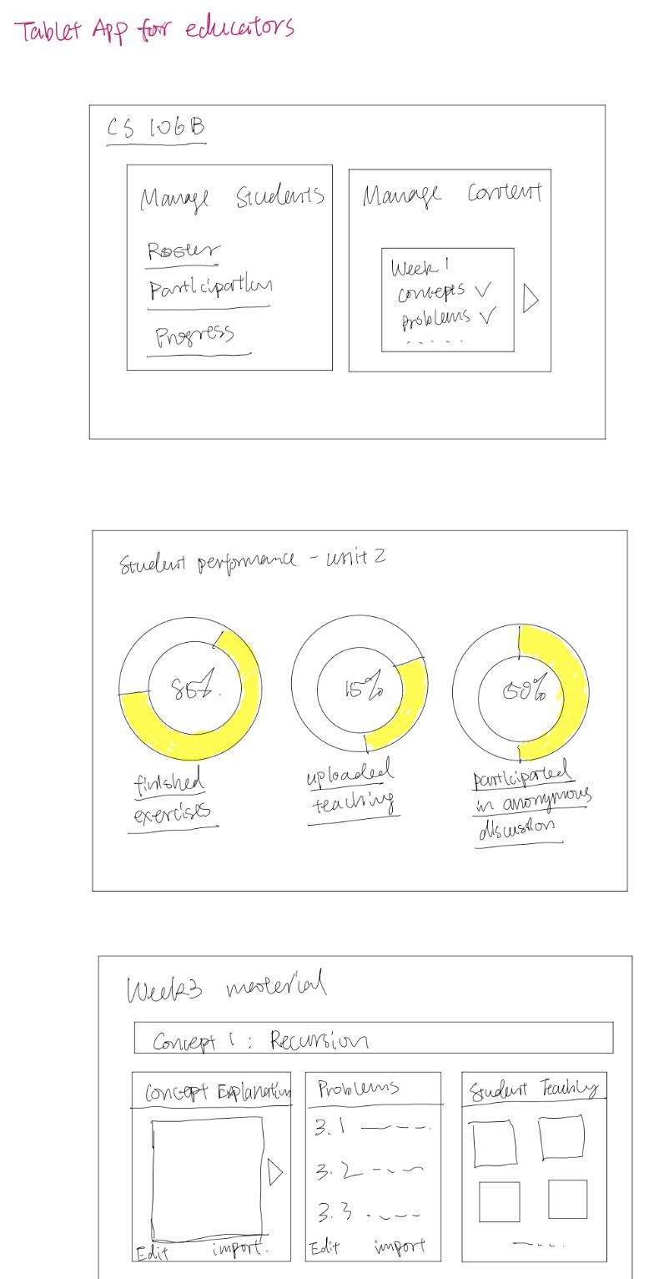
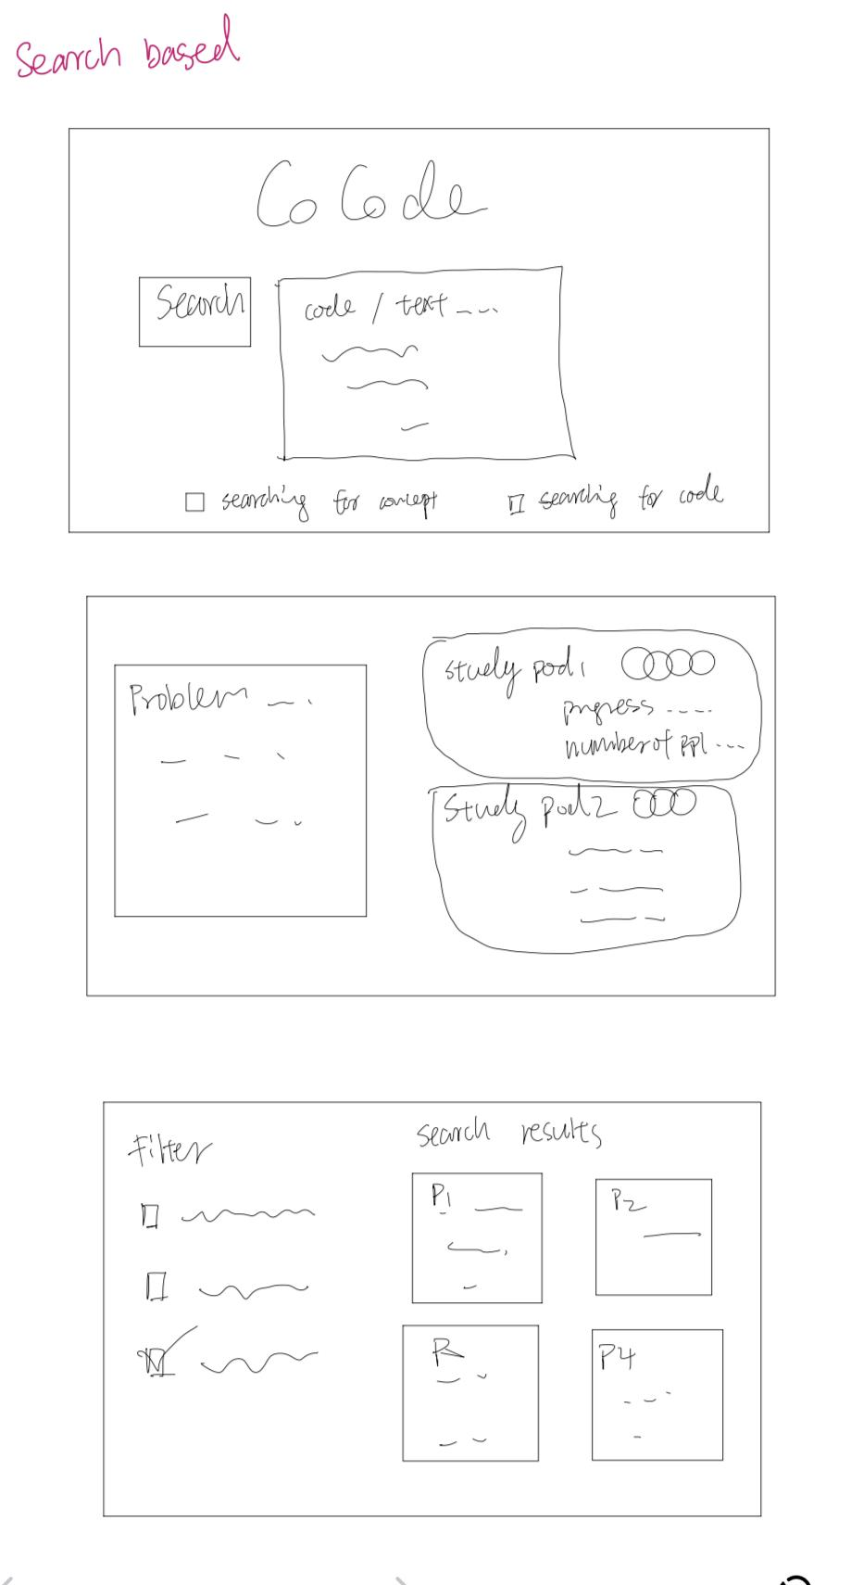
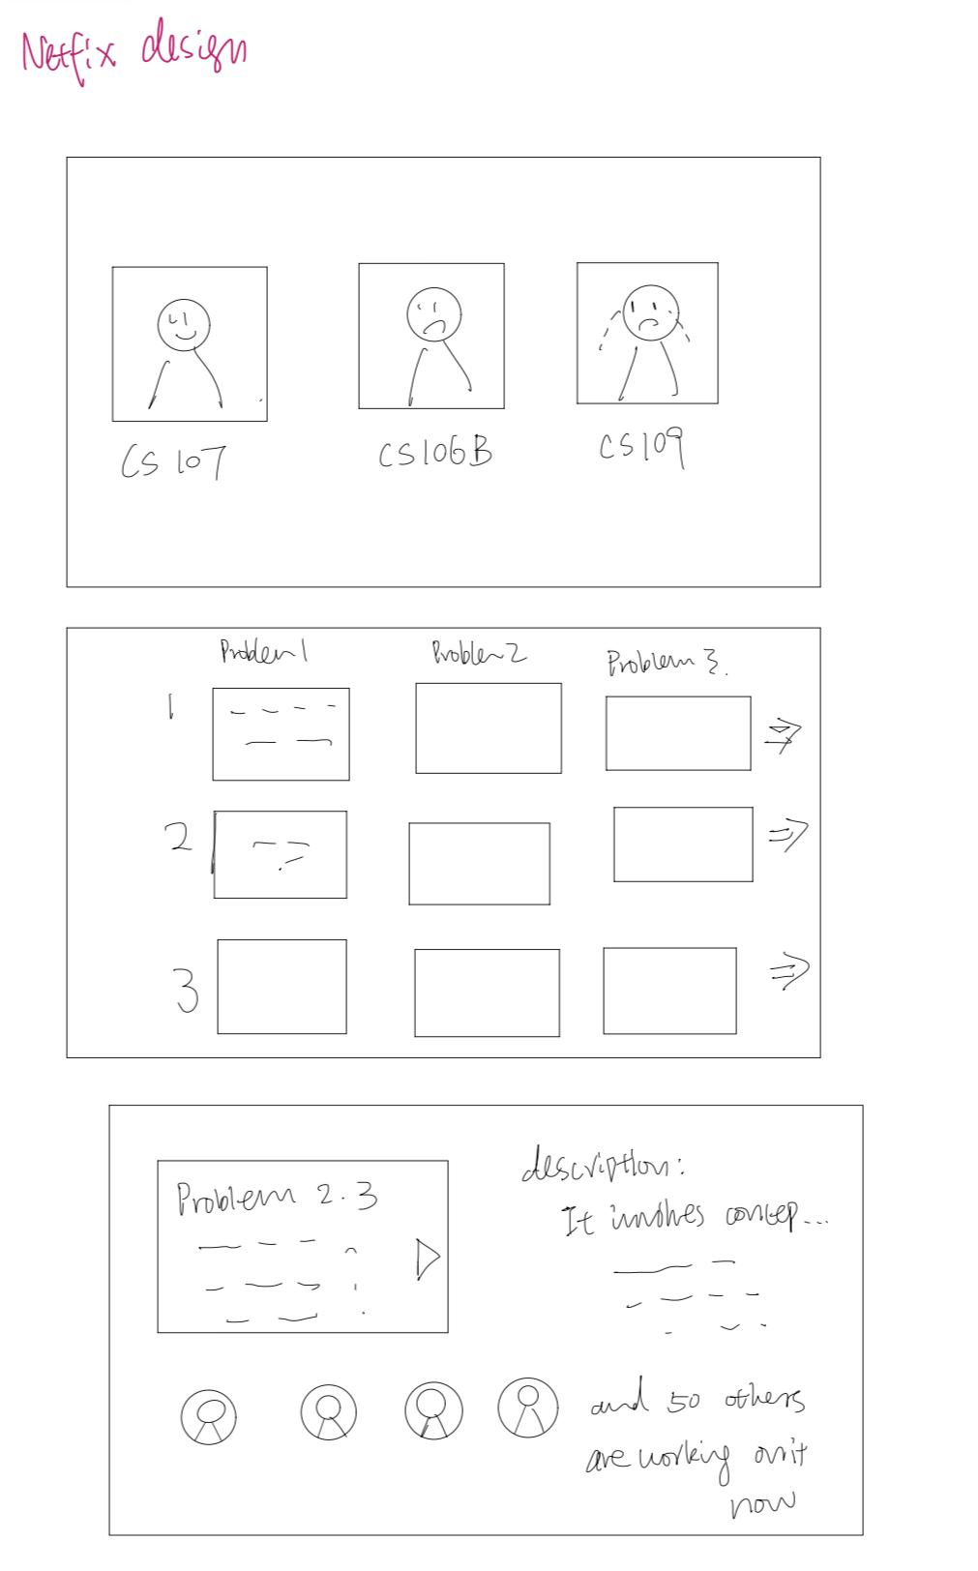
Concept Sketches

Slide 28
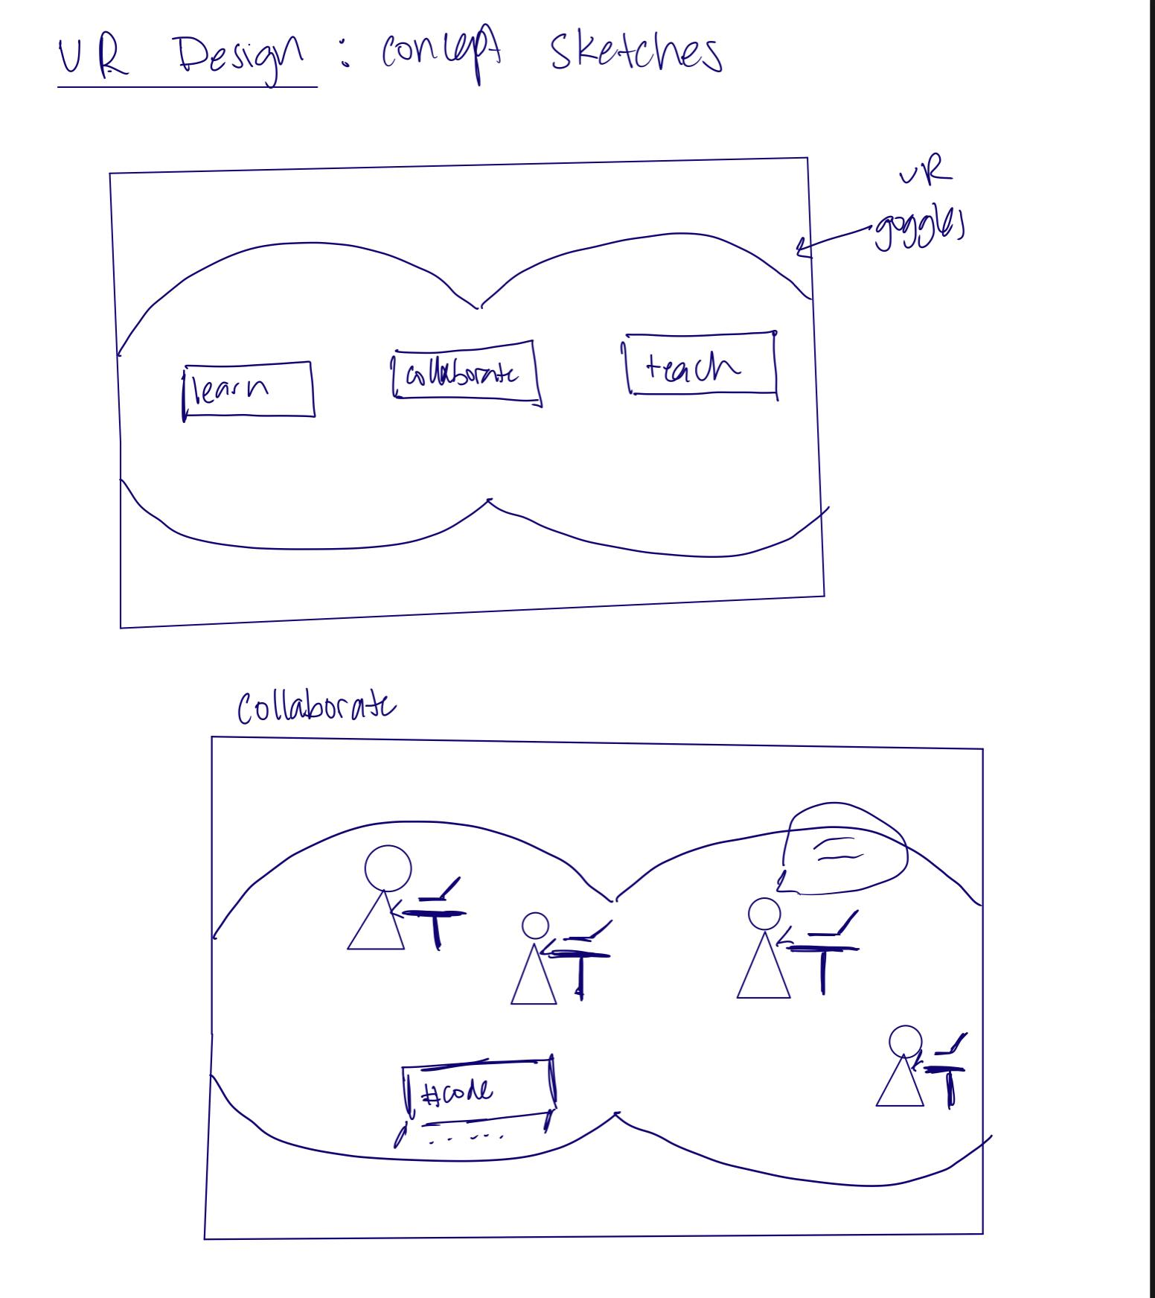
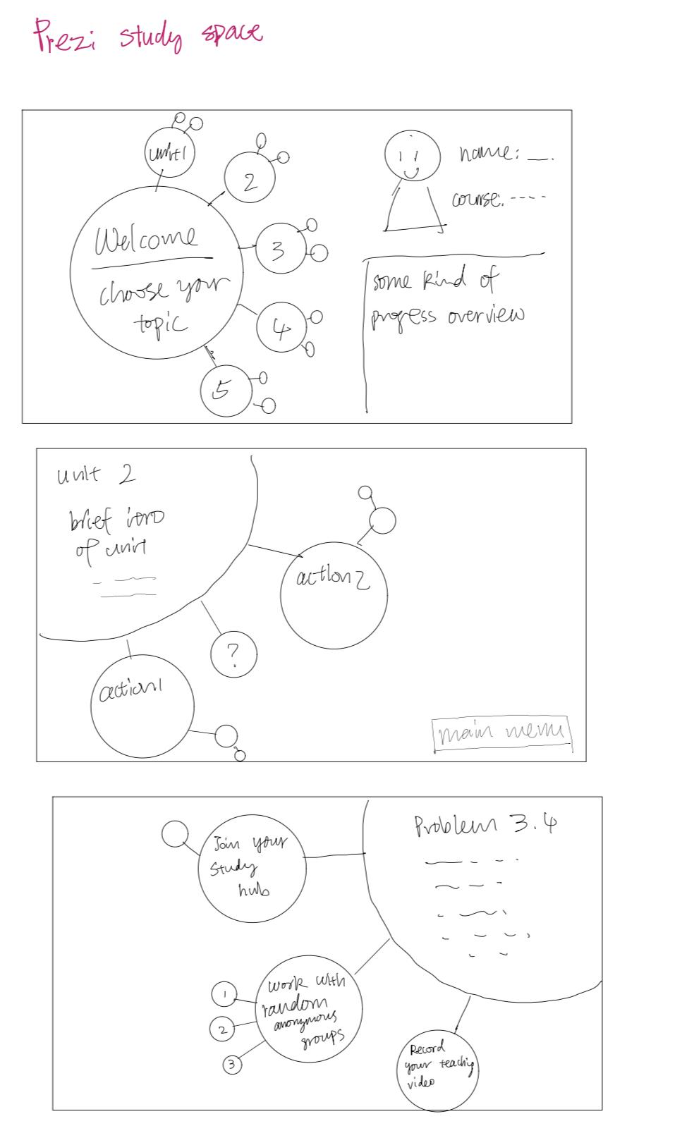
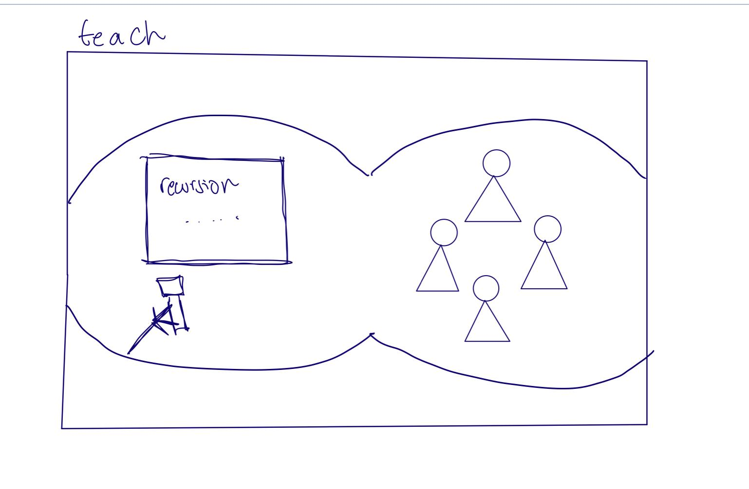

Slide 29
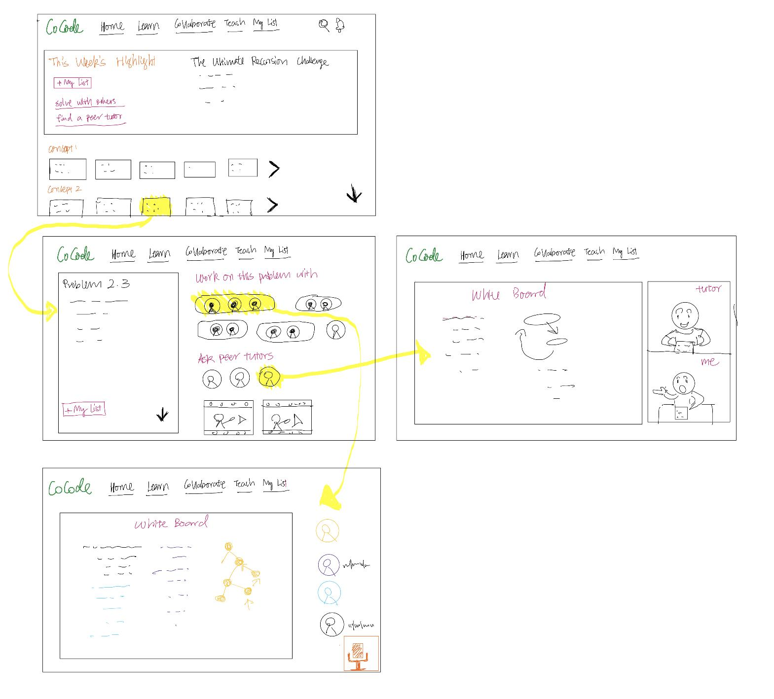
UI Sketches

Slide 30
